Slide 1

First major project of Machine Learning
Building Neural Network for Digit Recogintion

Slide 2
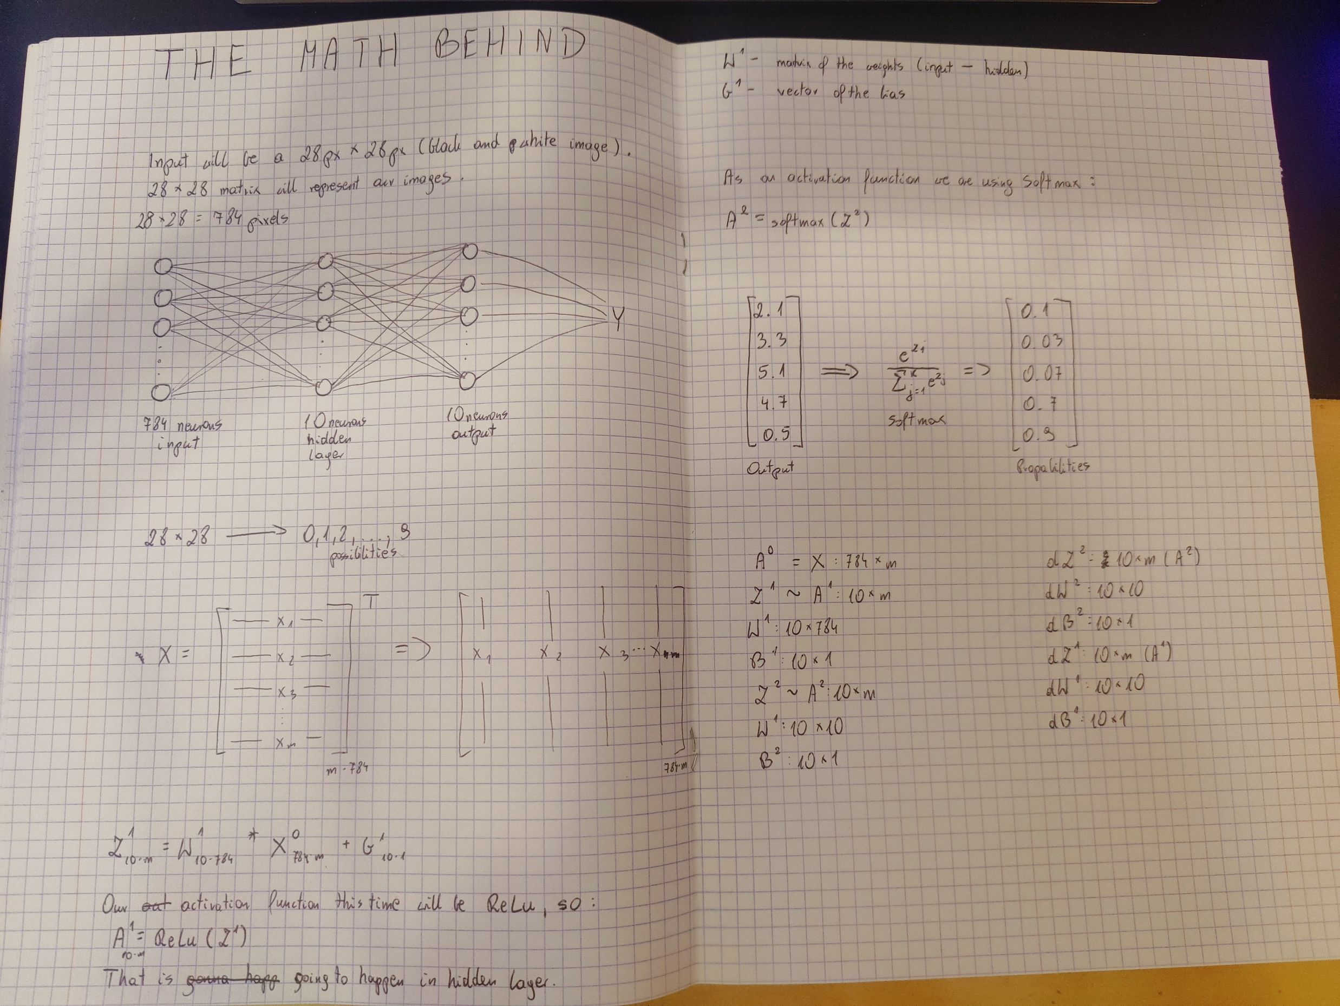
MAth Behind the project
I built a two-layer neural network to classify handwritten digits from the MNIST dataset. Implemented entirely in Python using NumPy for numerical computations, this project aimed to deepen my grasp of the core mathematical principles behind neural networks.
This approach, which bypassed the use of high-level machine learning libraries, provided a valuable hands-on learning experience.

Slide 3
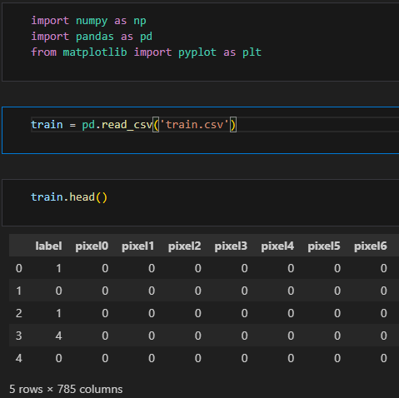
Code IMPLEMENTATION
The rest of the code here:
https://github.com/1syriusz1/Digit-Recognizer

Slide 4
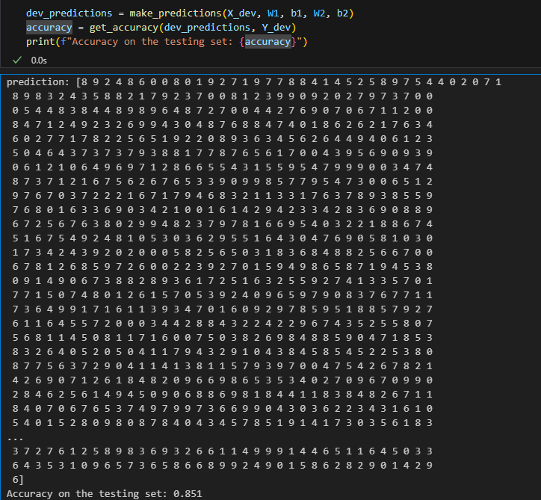
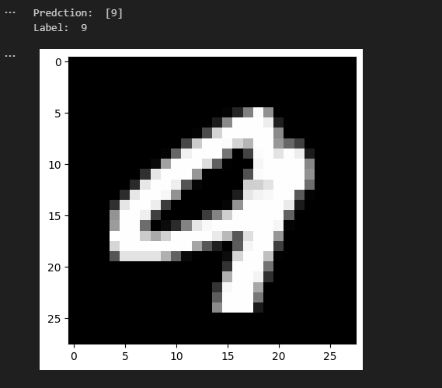
Results

Slide 5

Thanks for your time

